Slide 1
Transactions, Reads, Locks
Serializable TXs
Isolation Level
Locks: Shared, Exclusive
Deadlocks

Slide 2
What is Concurrency Control?
Remember ACID from first database course?
Atomic, Consistent, Isolation, Durable
Serializable TXs – Sorting of TX events in order:
When the sorting of transactions in the order they occur is critical to the application. Think anything finance oriented.
Lock based
Time-Stamp based
Validation based

Slide 3
Transactions: For “itchy execute trigger fingers”
begin tran; --begins TXs, places a lock on row or table
commit tran; --TXs is now durable, releases lock
rollback tran; --TX is failed, no change made, releases lock
Begin Tran
Makes the TX “explicit”
Similar to NOEXEC option
TX will not execute until…
Commit Tran
We will use explicit TX for demonstrating locking scenarios when accessing multi user database, not just your laptop!
https://www.mssqltips.com/sqlservertutorial/3305/what-does-begin-tran-rollback-tran-and-commit-tran-mean/
https://docs.microsoft.com/en-us/sql/t-sql/language-elements/begin-transaction-transact-sql?view=sql-server-2017

Slide 4
Lock Elements
Serialized TXs
Reads, Writes
Isolation level
Locks: Shared, Exclusive
Deadlock and how to resolve
Wound-Wait, Wait-die
Options, Hints

Slide 5
What is Locking?
Binary
Shared/Exclusive
2 Phase Locking Protocol (2PL):
Growing/shrinking
Acquiring/releasing
Strict 2PL
Lock Hierarchy: Row, Page, Table, Database
Lock Escalation: Mechanism that increases locks to next higher level.
Lock Threshold: Boundary condition at which system escalates to next level.
Example: A 5,000 lock TX will escalate to table level.
This could be a real problem when you have partitioned tables and when you are rebuilding indexes.

Slide 6
Options
Options
Lock_Escalation (table, auto, disabled)
With(Allow_page_locks = on/off)
With(Allow_row_locks = on/off)
A walkthrough for altering lock escalation: https://www.mssqltips.com/sqlservertip/4359/altering-lock-escalation-for-sql-server-tables/

Slide 7
Remember “Table Hints”?
With( )
HOLDLOCK
NOLOCK
NOWAIT
PAGLOCK
READCOMMITTED
READCOMMITTEDLOCK
READPAST
READUNCOMMITTED
REPEATABLEREAD
ROWLOCK
SERIALIZABLE
TABLOCK
TABLOCKX
UPDLOCK
XLOCK
https://www.sswug.org/alexanderchigrik/sql-server/some-tips-for-using-table-hints-in-sql-server-2016/
http://www.informit.com/articles/article.aspx?p=27020

Slide 8
Comprehensive Explanation of all of this:
https://docs.microsoft.com/en-us/sql/relational-databases/sql-server-transaction-locking-and-row-versioning-guide?view=sql-server-2017
All about locking!
https://www.sqlshack.com/locking-sql-server/

Slide 9
Practical Example
Replicated copies (federated system)
Local read, may not reflect update from other location.
Local update, latency gap until cascaded through out all locations.
Non-critical (CAP) eventual, push update across all copies.
Critical (ACID), acquire locks from all copies first, then update, then release locks.
Communication overhead:
request lock message→
acknowledgement message ←
update message →
acknowledgement message ←
release lock message→

Slide 10
Settings for Locks and Isolation Level in SSMS

Slide 11
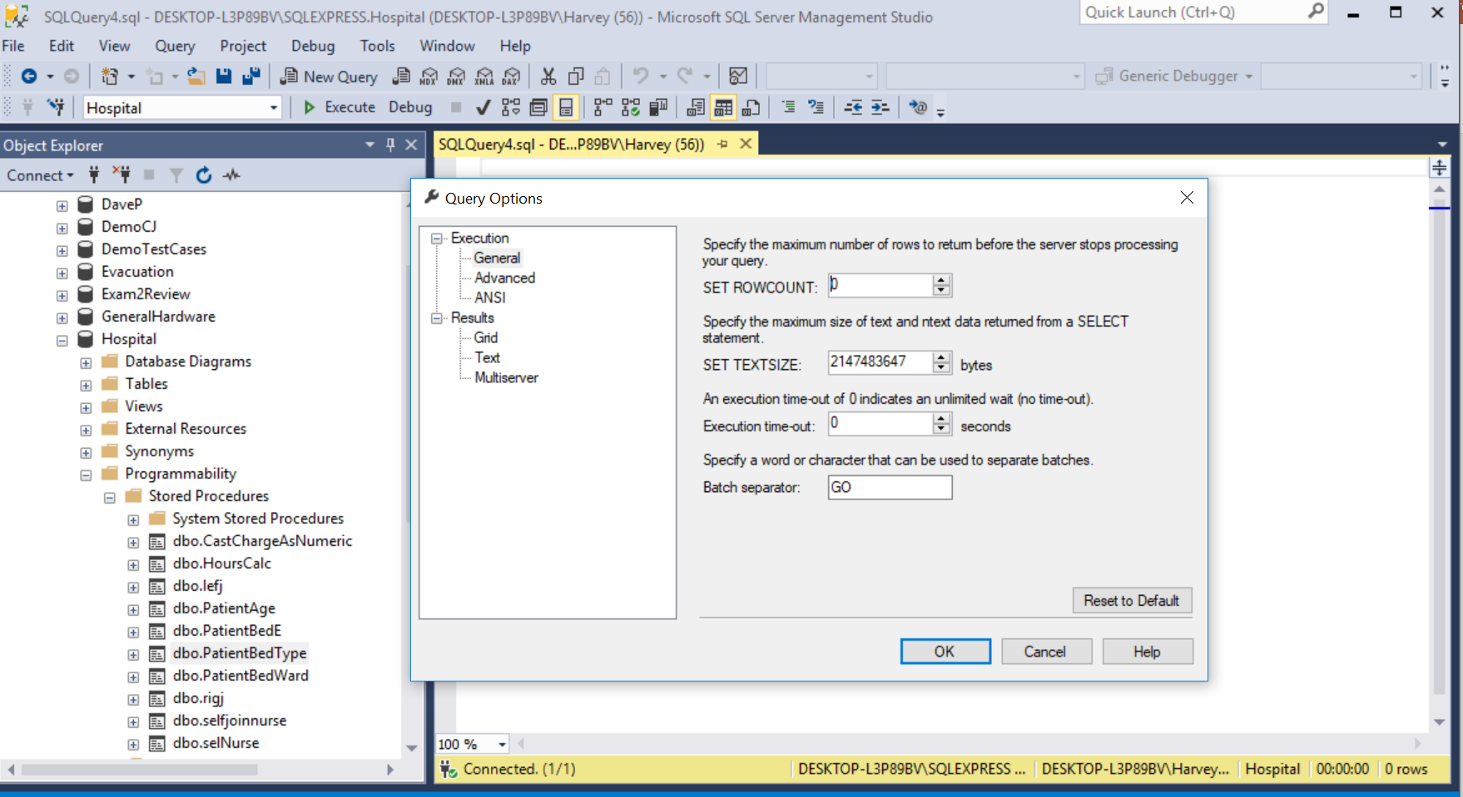

Slide 12
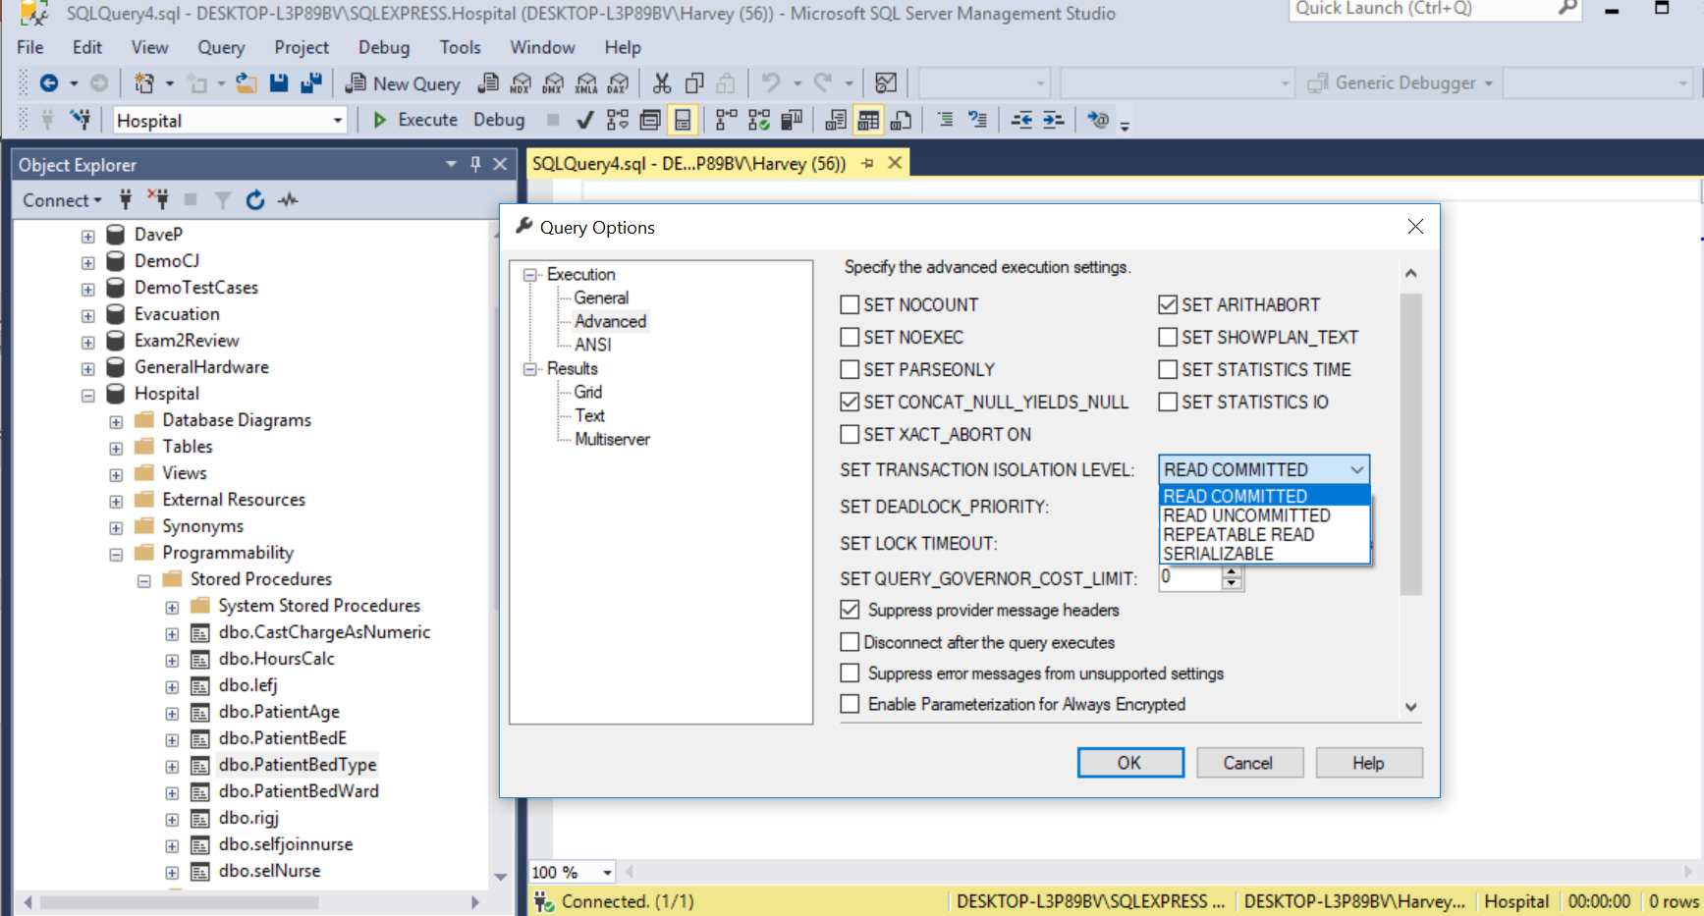
4 levels of isolation

Slide 13
What is Isolation?
Read committed
Read uncommitted (also called “NOLOCK” – potential for “dirty reads”)
Repeatable Read (potential for “phantom reads”)
Serializable
Row versioning
Snapshot Isolation (SI) – default in Azure.
Read Committed Snapshot
https://thesqlgirl.com/2016/11/02/row-versioning-based-isolation-levels/
https://docs.microsoft.com/en-us/sql/relational-databases/sql-server-transaction-locking-and-row-versioning-guide?view=sql-server-2017
https://www.red-gate.com/simple-talk/sql/t-sql-programming/row-versioning-concurrency-in-sql-server/

Slide 14
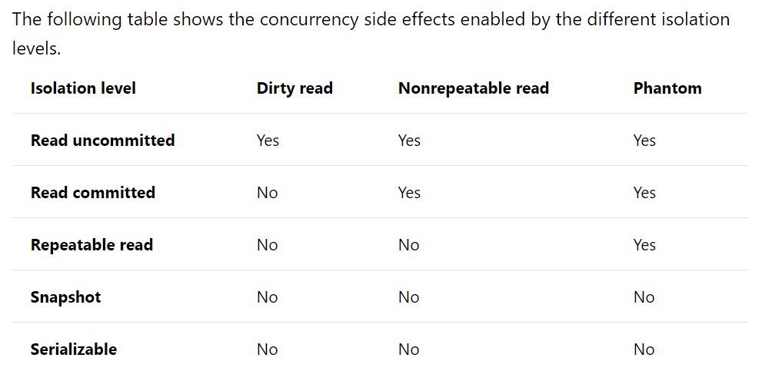

Slide 15
Concurrency Skill Exercise
Part I:
Run a series of experiments demonstrating the following:
The 4 isolation levels.
Compare with row versioning (snapshot)
3 locking options.
4 table hints.
Must support a user story.
Part II:
You must update a record across a federated database demonstrating:
SQL code for acquiring exclusive locks across all copies,
SQL code for acquiring a shared lock,
SQL code for a no lock update.
Must include topology graphic depiction.

